Slide 1

to Our Presentation

Slide 2
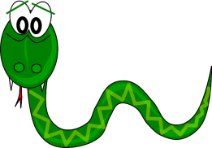

A Presentation On SNAKE GAME
Group Members
Supervised by
Md. Anwar Hussen Wadud
Lecturer Department of Computer Science & Engineering
Name | ID
Arifur Rahaman Ovi | 18192103141
Md .Mahmudul Hassan | 18192103139
Mahbubur Rahman Khan Meftahul Jannat | 18192103150 18192103149

Slide 3

Outlines
Contents
• Introduction of project
• History of Snake Game
• Requirements
• Objective
• ER Diagram
• Features & About the project?
• Computer Graphics
• Testing
• Future scope of the program
• References

Slide 4
Introduction
The game called "snake" or "snake game" typically involve the player
Controlling a line or snake, there is no official version of the game, so
Gameplay varies. The most common version of the game involves the snake
Or line eating items which make it longer, with the objective being to avoid
Running into a border or the snake itself for as long as possible.

Slide 5
Objectives
 This project in C language of snake game is a simple console
Application with very simple graphics. In this project, you can play the
Popular “snake game” just like you played it elsewhere. You have to
Use the up, down, right or left arrows to move the snake.
 Foods are provided at the several co-ordinates of the screen for the

Slide 6
stdio stands for standard Input Output. It is header file in C which has definitions for input/output related functions , whenever you using built-in functions like printf(), scanf(), getc(), putc() etc.
#include <stdio.h>
#include <conio.h>
#include <windows.h>
#include <time.h>
conio stands for console input output. It is a header file in C which has definitions for console related functions, whenever you using built-in functions like clrscr(), getch() etc
Window.h also contain declaration of from basic windows dll like User32.dll, which contain api’s for accessing heart of Operating system.
In C programming language time.h is a header
file defined in the C Standard Library that
contains time and date function declarations to
provide standardized access to time/date manipulation and formatting.

Slide 7
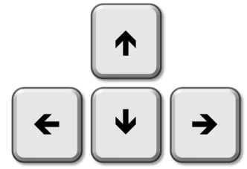
How the Snake Game Draws
the Snake!
The snake is drawn one pixel at a time .
Uses the PSet command.
User click on one of the path’s
directional command buttons to
change the path of the snake.

Slide 8
Let's create faster button!
Add a command botton above the Up button.
Set the Name property to cmdspeed.
Double click the Faster command button and add code to toggle the speed at which the snake moves and to change the caption of the command button.

Slide 9
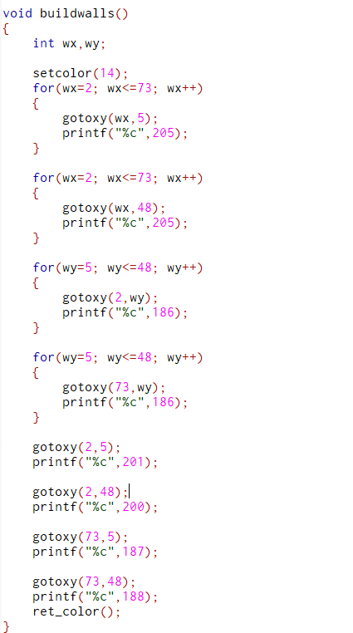
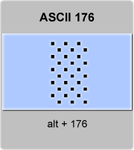
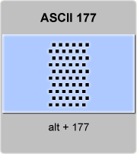
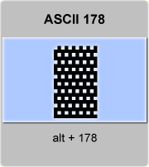
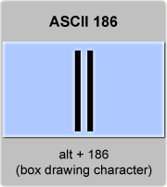
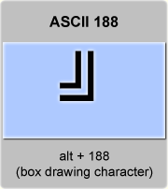
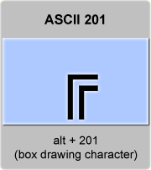
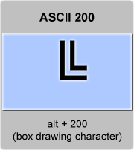
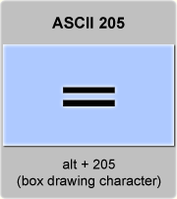
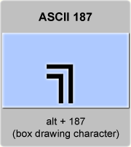
ASCII
Using to ASCII in this code

Slide 10
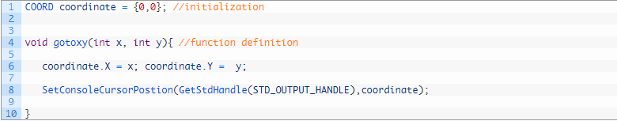
gotoxy() function
gotoxy() is build in function. You need not have to write its function definition. All you have to do is call the function with arguments as x and y coordinate. But in modern C compilers like gcc and IDE Code::Blocks, gotoxy() is not build-in function, you have to define it before use them. The following code is the function definition for gotoxy(). Remember: This function only works on windows, because the function definition includes functions of header file “windows.h”. So to use gotoxy() you must include “windows.h”.

Slide 11
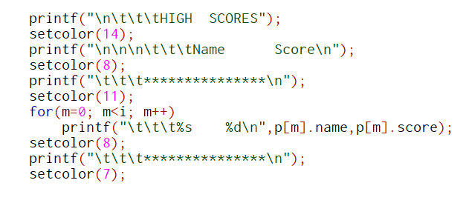
COLOR INT VALUES ------
BLACK 0 BLUE 1
GREEN 2
CYAN 3
RED 4
MAGENTA 5
BROWN 6
LIGHTGRAY 7
DARKGRAY 8
LIGHTBLUE 9
LIGHTGREEN 10
LIGHTCYAN 11
LIGHTRED 12
LIGHTMAGENTA 13
YELLOW 14
WHITE 15
Setcolor function

Slide 12
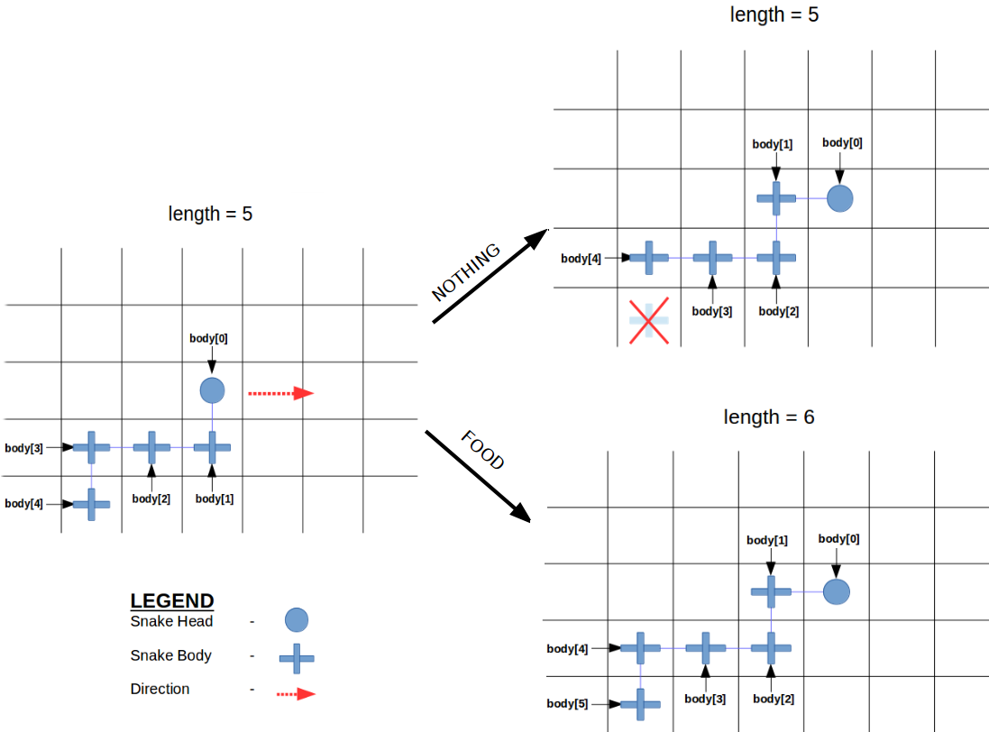
Array size can be extended to increase snake length !

Slide 13
Example:
Spx is Zero because there is no change to the x coorodinate.
Spx = 0
Spy = 1
Spx = 1
Spy = 0
Spx is on e because the X coordinate must increase by one pixel with each repetition of the loop.the Y dose not change because it is horizontal!!
Spy is one because with each repetition of the loop the Y coordinate must increase y one pixel

Slide 14
Moving the snake Up and left Requies a negative number because it is moving to the top or left…
Move the snake to the left the spX must be a negative number..
This will move the snake to the left
Spx = 0
Spy = -1
spX = -1
spY = 0
Example

Slide 15
ER DIAGRAM
START
Enter the main menu of snake game
Press any key to start
Enter name
Play game
quit
Do you want to continue
STOP

Slide 16
Features & About The Project
 This snake game is just similar to games which are found under mobile
Games section. It uses the concept of graphics to display the menu items
And all objects on a single screen.
 Players will able to check their result after games get over.
 The score section will display the total score of the player, game level and
Maze which has been used.
 The object snake position has been set random, so whenever player will
Start the game, the snake will appear at random location every time.
 The snake object will always appear in green color.
 The number keys “up,down,left,right” has been set within the program to move the
Snake to right, left, top and bottom respectively

Slide 17
Computer Graphics ❏ Computer Graphics is one of the most powerful and interesting aspect of computers. ❏ There are many things we can do in graphics apart from drawing figures of various shapes. ❏ All video games, animation, multimedia predominantly works using computer graphics. Graphics in C ❏ There is a large number of functions in C which are used for putting pixel on a graphic screen to form lines, shapes and patterns. ❏ The Default output mode of C language programs is “Text” mode. ❏ We have to switch to “Graphic” mode before drawing any graphical shape like line, rectangle, circle etc. 9
❏ The initgraph function takes three arguments
❏ Graphics mode must be closed at the end
intigraph(&graphics_driver,&graphics_mode,Path _to_driver);
closegraph();

Slide 18
Testing & Screenshots
Testing is the major control measure used during software
development. Its basic function is to detect errors in the software.
During requirement analysis and design, the output is a document that
is usually textual and no executable. After the coding phase, computer
programs are available that can be executed for testing purpose. This
implies that testing not only, has to uncover errors introduced during
coding, but also errors introduced during previous phase. Thus the goal
of testing is to uncover the requirements, design and coding errors in

Slide 19
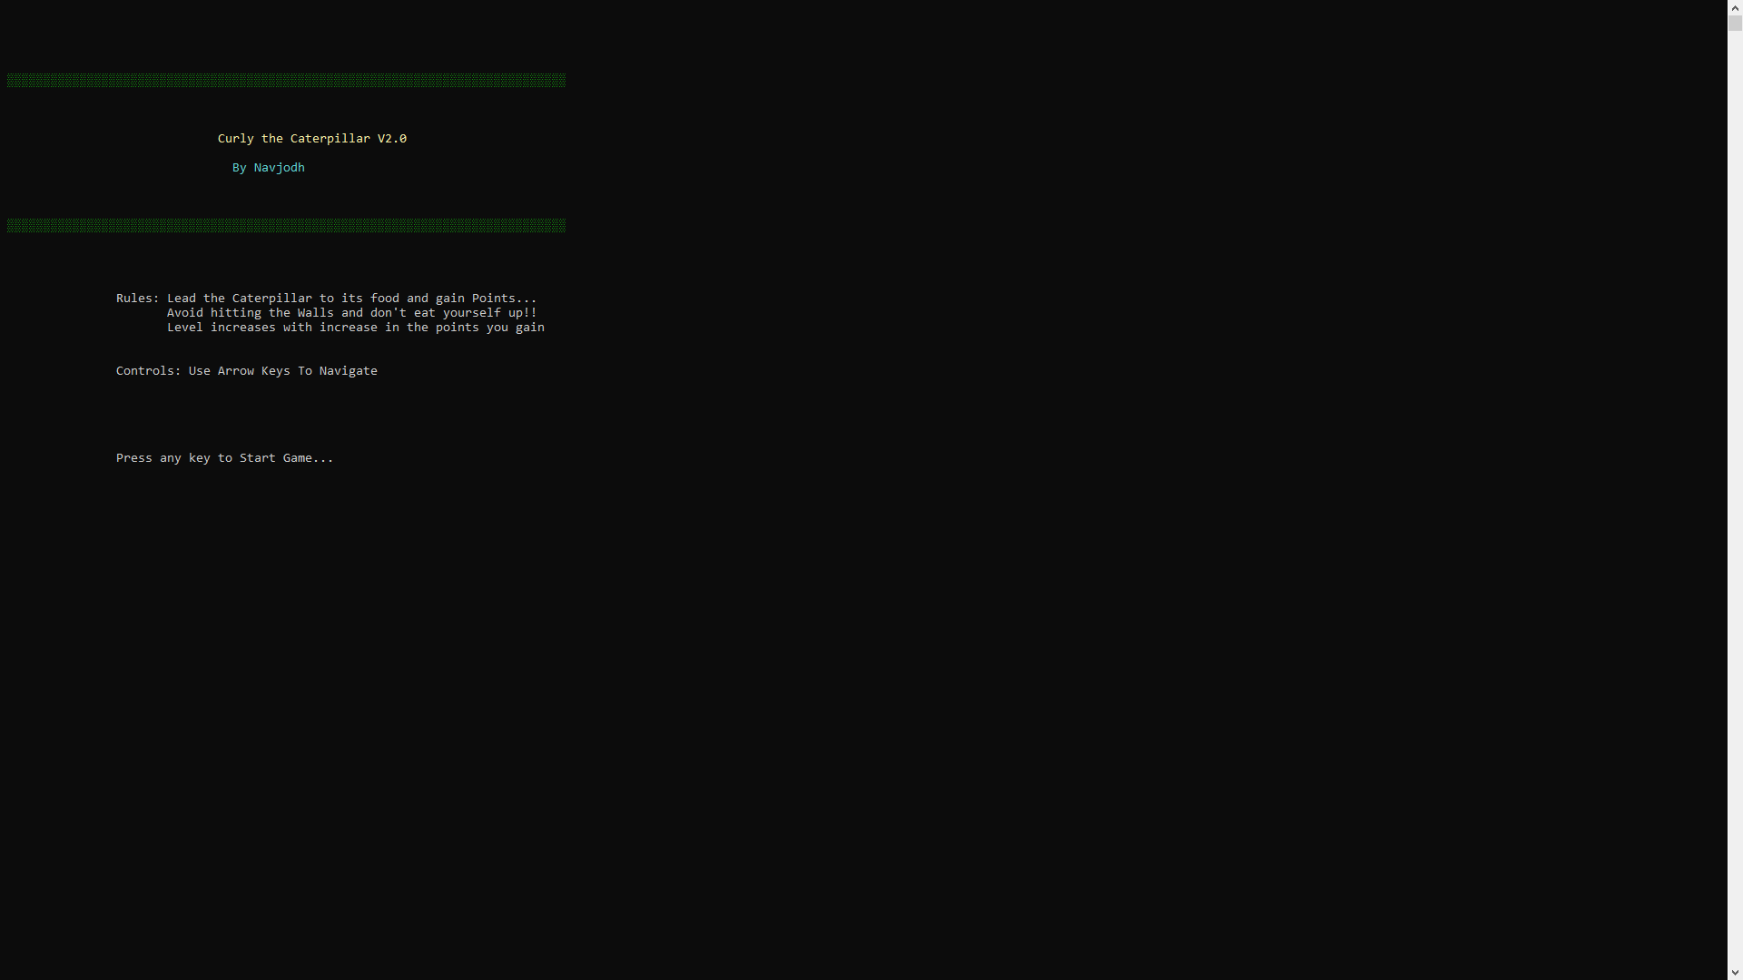
Main menu

Slide 20
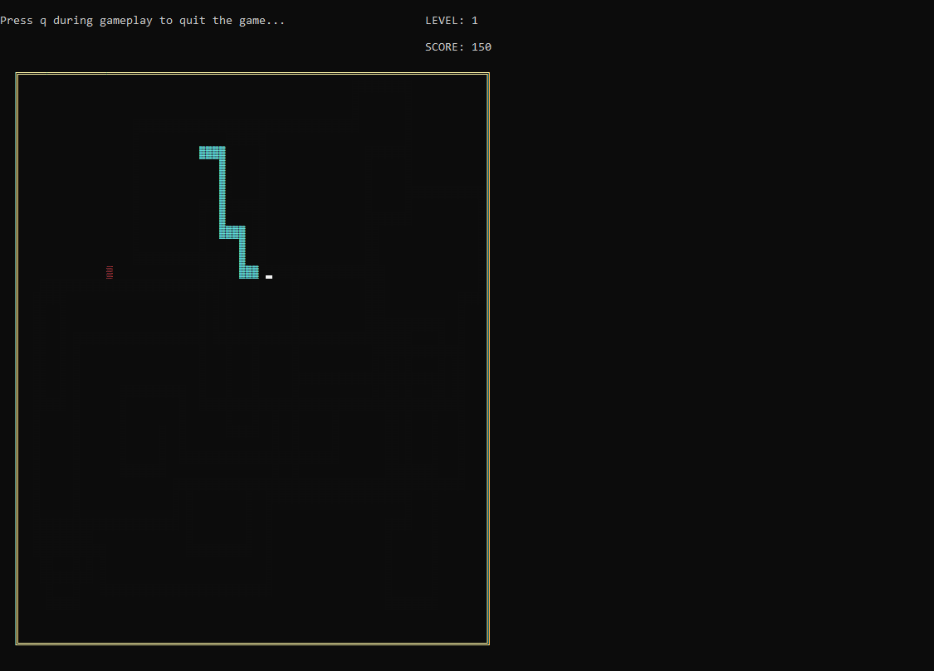
playing

Slide 21
FUTURE SCOPE OF THE PROJECT
Our project will be able to implement in future after
Making some changes and modifications as we make our
Project at a very low level. So the modifications that can be
Done in our project are:
1.It can be made with good graphics.
2.We can add more options like top scores and player profile
3. We can add multiplayer option

Slide 22
References
https://en.wikipedia.org/wiki
https://www.youtube.com
https://www.cs.bham.ac.uk
Books
a. Let us C by Yashwant Kanetkar
b. Programming with C by E Balagurusamy
c. Graphics under C by Yashwant Kanetkar

Slide 23


